Slide 1
Case Study: How Affordable is Housing in Ireland
Questions:
Can someone on “Average” wage afford housing:
In Ireland
In Dublin
How much of “affordable” housing is multi bedroom – for Families?
What locations are priced towards Average Salaries

Slide 2
Definitions & Assumptions
Average Salary: 38.2K as of 2017 Q4 - CSO
Assuming no other savings besides deposit
Max Loan Amounts(Thousands)
Cutting off tail greater than 1 million euros.
Figures based on asking price, not selling price
Buyer | Salary | Loan Multiplier | Deposit | Total
FTB | 38.2 | 3.5 | 13.3 | 147.1
FTB Joint | 76.4 | 3.5 | 26.7 | 294.1
STB | 38.2 | 3.5 | 26.74 | 160.4
STB Joint | 76.4 | 3.5 | 53.5 | 320.8
Notes:
Average salary not the best measure (median or mode). (5 people on 20k & 1 person on 1 million gives average salary of 183k
Eliminating variables such as savings etc.
Removing some sku

Slide 3
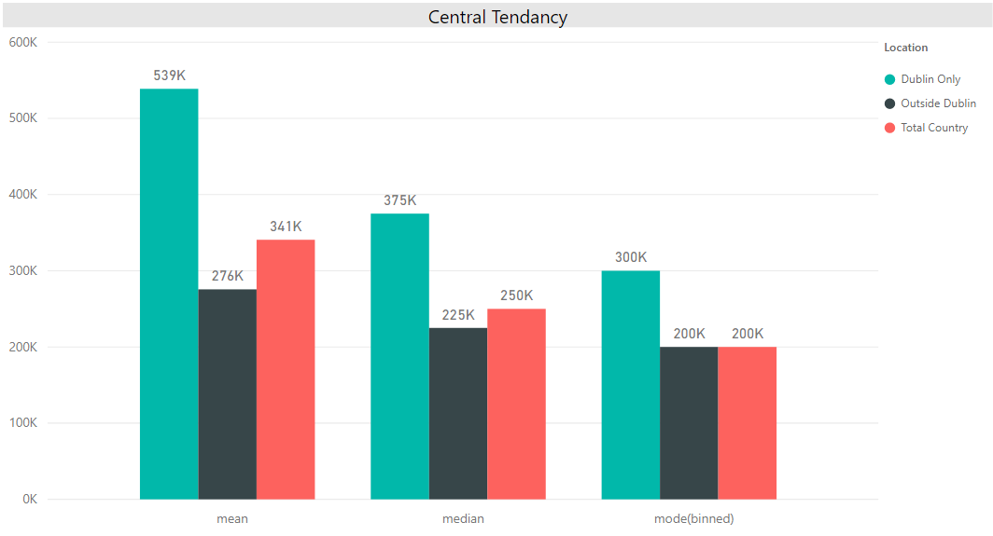
High Level Statistics
Average Price Comparison flawed due to skew
Med & Mode indicate Dublin is roughly 33% more expensive
Largest number of Dublin properties in the 280-300k bracket.
Largest number of properties outside of Dublin in 180-200k bracket.
Notes:
skew in Dublin prices influences Mean.
Houses grouped by price in bins incrementing by 20k

Slide 4
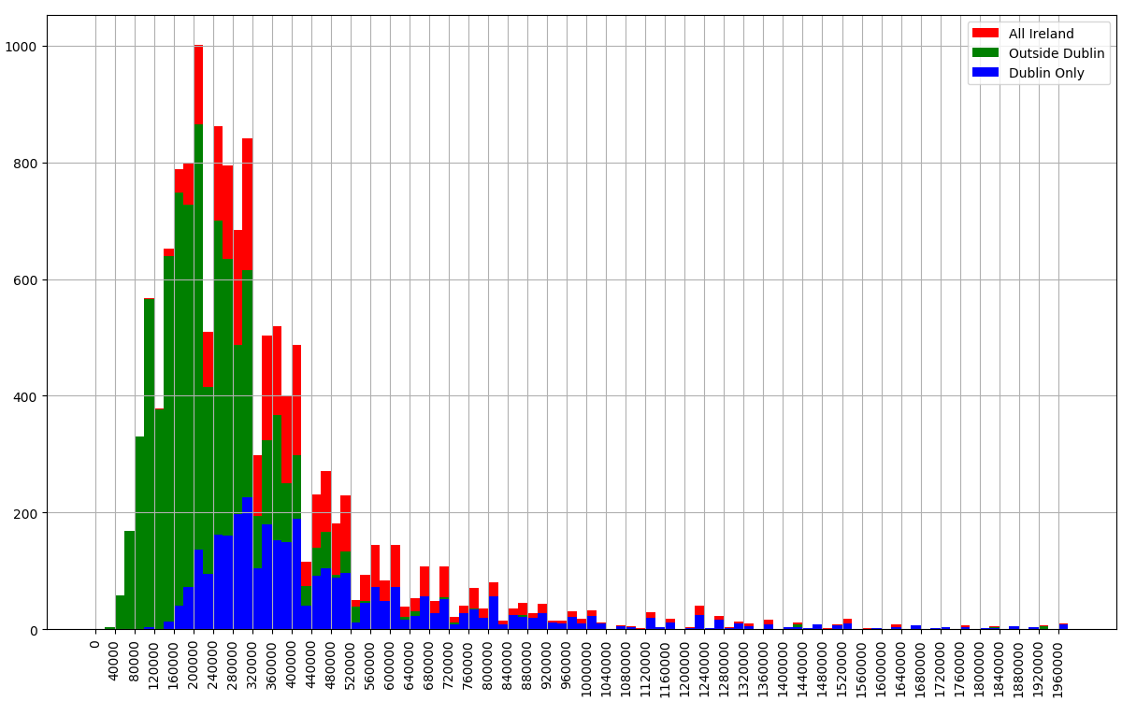
Housing Availability for Average Income (Corrected Sale Price)
Joint FTB 7% in Dublin (987)
51% outside Dublin (7006)
Individual FTB (147.1K)
0.2% in Dublin, 27
17% outside Dublin, 2371
Joint FTB (294.1K)
7% of in Dublin, 987
51% outside Dublin, 7006
2nd Time Buyers have higher max due to higher deposit
Individual
0.4% in Dublin, 63
22% outside Dublin, 3030
Joint
9.1% inside Dublin, 7610
56% outside Dublin, 1235
Individual FTB
0.2% in Dublin (27)
17% outside Dublin (2371)
Notes:
Individual FTB: 0.8% of Properties against Total Dublin Sample
Joint FTB: 29% of Properties against Total Dublin Sample

Slide 5
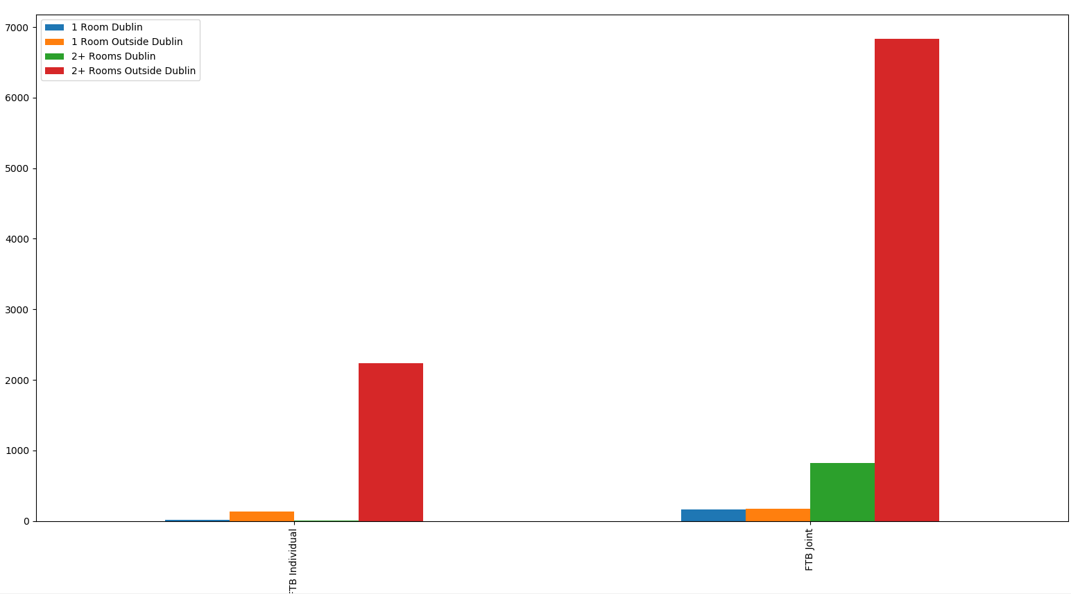
Properties with > 1 Room
Families require more than one bedroom.
 | 2+ Rooms in Dublin | 2+ Rooms Outside Dublin
Individual FTB | 9 | 2237
Joint FTB | 826 | 6837
Notes:
Families need two incomes to afford property

Slide 6
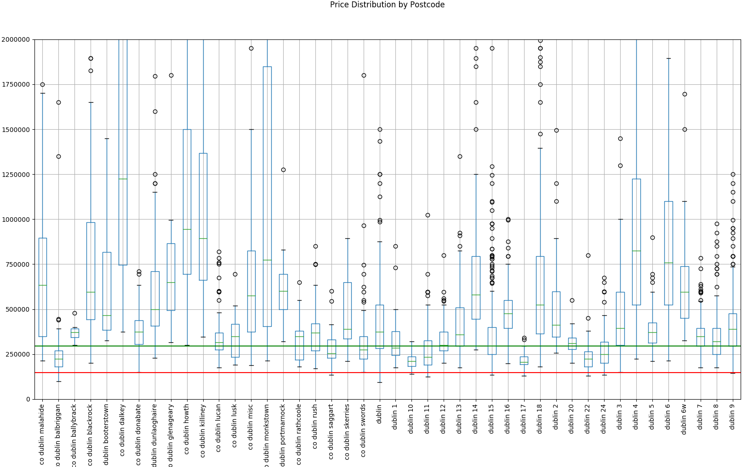
Dublin Price Distribution
N.B – Shows Distribution, not quantities
Joint FTB:
Balbriggan, D11, D15, D8, D22, D24
Individual FTB:
Balbriggan, D15, D17.
All very low percentiles

Slide 7
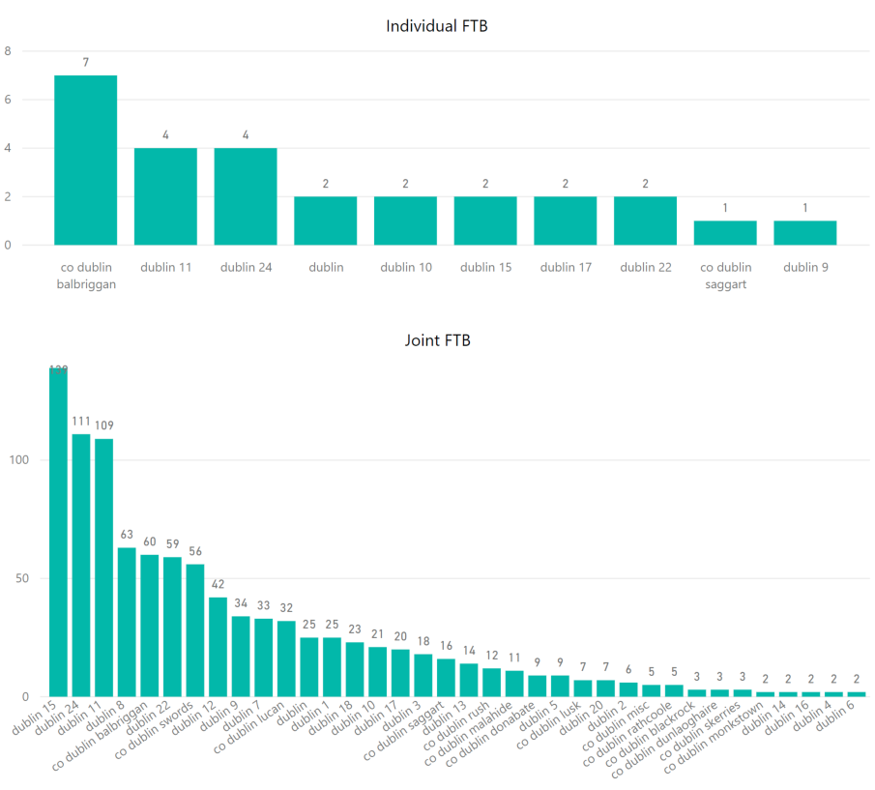
Location – Within Dublin
North & West Dublin
D15 – Blanchestown, Ashtown, Clonsilla, Ongar, Clonee, Tyrrelstown
D24 – Tallaght, Citywest, Firhouse, Ballycullen
D11 – Finglas East, Glassnevin
D8 – SCR, Inchicore, Rialto, Christchurch, Kilmainham
D10 – Ballyfermot, Cherry Orchard
Little option for Individuals
Notes:
D15 – Blanchestown, Ashtown, Clonsilla, Ongar, Clonee, Tyrrelstown
D24 – Tallaght, Citywest, Firhouse, Ballycullen
D11 – Finglas East, Glassnevin
D8 – SCR, Inchicore, Rialto, Christchurch, Kilmainham
D10 – Ballyfermot, Cherry Orchard

Slide 8
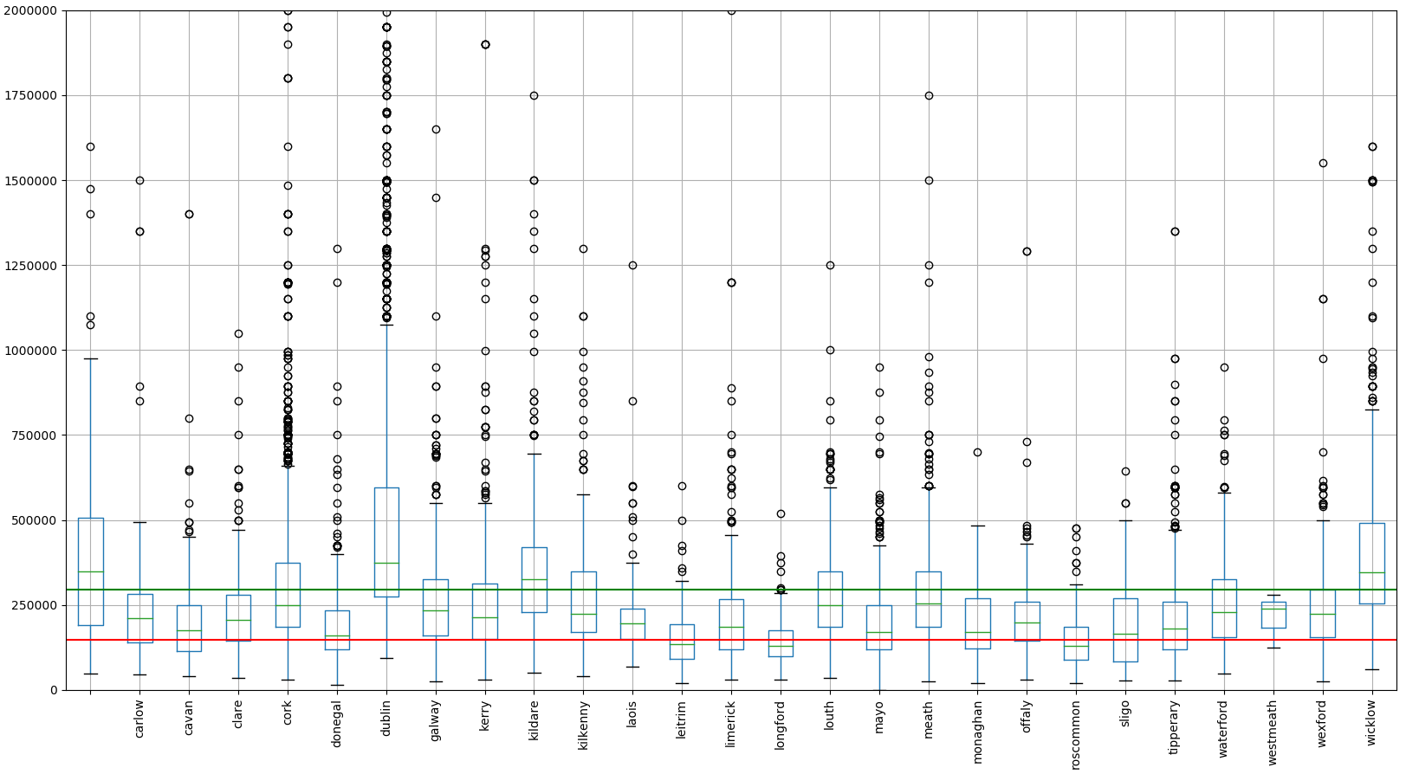
Full Country Price Distribution
N.B – Shows Distribution, not quantities
More options in West of Ireland
Picture looks better for individual FTB’ers
Notes:
Individual FTB’ers above 25th percentile in West Leitrim, Longford, Roscommon, Sligo, and further south in Tipp & Longford
Joint FTB’ers borrowing limit above 50th percentile in most counties.

Slide 9
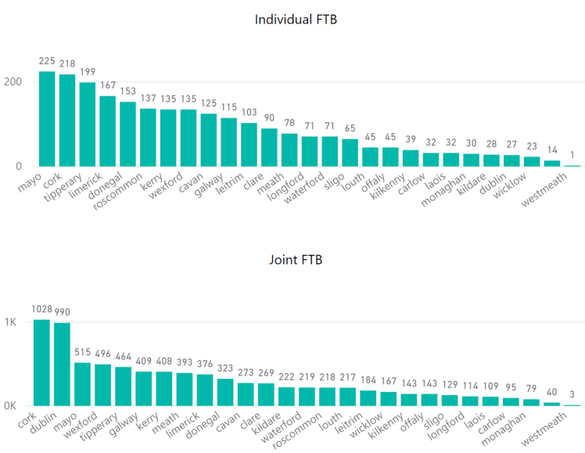
Location – Outside Dublin
More choice for Individuals
Cork
Dublin ranks highly for Joint FTB’ers
Indicate shortage countrywide?
Notes:
Cork contains a large City, potentially good destination – employment and housing.
Dublin 2nd for joint buyers

Slide 10
Conclusions
Individual First Time Buyers have very little options in Dublin
Decentralisation, Longer Commutes
Dublin prices demand two incomes
Families (2+ bedrooms) within Dublin have little choice
Single income families have no choice
North & West Dublin cater to “Average Wage”
Second Time Buyers have higher limit but only due to higher deposit
Inability to raise deposit may hinder Second Time Buyers
Many more options outside Dublin
Overall numbers of property available is still very low

Slide 11
Environment
Anaconda distribution of Python
PowerBI
Data Storage – SQL, CSV
Notes:
Anaconda, easy to use installer, many libraries included, comes with good IDE.
PowerBI, because im familiar with it

Slide 12
Dataset
Property for sale
Snapshot from popular property website, mid Feb 2018
Obtained via “Screen Scraping”
Python - selenium, Beautiful Soup
12.9k distinct clean rows
Sample – not full population
Biased?
Notes:
Biased? Only accessable to sellers who use the internet. Small bias but illustrates the problem

Slide 13
Cleansing (Data Munging)
Clean and shape the data into something usable
Consumes roughly 90% of the total time
Python, excel, SQL, PowerBI
Decisions to make:
When to discard data
How to populate missing values
Feature Generation
Price Binning
Location

Slide 14
Analysis & Visualization
Define clear quantifiable questions
Basic understanding of Stats – Mean, median, mode, box plot
Good understanding of the data domain
Regions, Deeper dive into Dublin, BER, single/multi room
Python
Pandas
Numpy
Matplotlib
PowerBI
Notes:
Quantifiable questions are required. Random exploration usually fruitless.
Advanced maths not required.
Domain Knowledge:
Dublin needs individual exploration
Families require multiroom
BER, what is it
Pandas – Data analysis functionality similar to R
Numpy – advanced mathemathical functionality for python & useful data structures
Matplotlib – plotting library for Python

Slide 15
Lessons in Dead Ends
Some questions/Analysis cannot be answered
Dataset too small
Missing Features
Sparse Columns
Biased Data
Skill Level
Machine Learning

Slide 16
Prediction & Machine Learning
Predict price based on size, location, BER & No. Rooms.
Poor accuracy, Mean Squared Error of 350K
Reasons:
Low correlation between No. Beds, Baths, Size & Price
Mostly based on categorical variable – Location
Require reasonable sample for every street in the country
Pricing granularity, varies from street to street.
3 bed A1 BER - Citywest: 309k, Kiliney: 720k
4 Bed A2 BER Kildare, same Estate, 305K, 420K
Many areas with very low number of properties
High Price fluctuation over short period
My Experience Level
Notes:
Thought there would be clear correlation.

Slide 17
Next Steps
Prediction
Obtain more data over time
Refine features based on more granular address
Better data allows New Questions
Selling rate based on location
Asking Price vs Selling Price
Obtain more granular salary values
Mean in Dublin vs rest of country
Median & mode for more rounded view

Slide 18
Lessons Learned
Get the basics right
Naming Conventions
Code reuse
Data types
Ask specific questions
Find balance between productivity & learning
Bigger = Better (Data Volumes)

Slide 19
References
CentralBank – Mortgage Measures
FTB
Single person Avg Mortgage: (38.2 x 3.5) = 133.7 + 13.7(deposit) = 147.4K
Couple Avg Mortgage: (38.2 x 2) x 3.5 = 267.4 + 26.7 deposit = 294K
STB
Single person Avg Mortgage: 133.7 + 26.74(deposit) = 160.4K
Couple Avg Mortgage: 267.4 + 53.5(deposit) = 321K
CSO Earnings
Property Price Register
Property Website

Slide 20
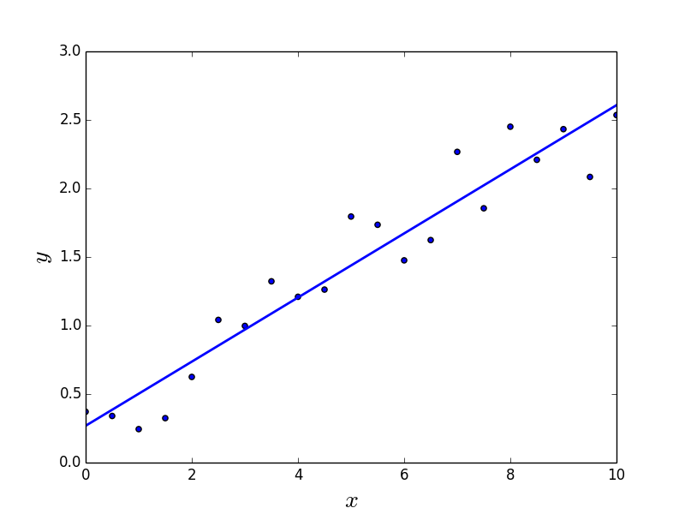
Linear Regression Desc

Slide 21
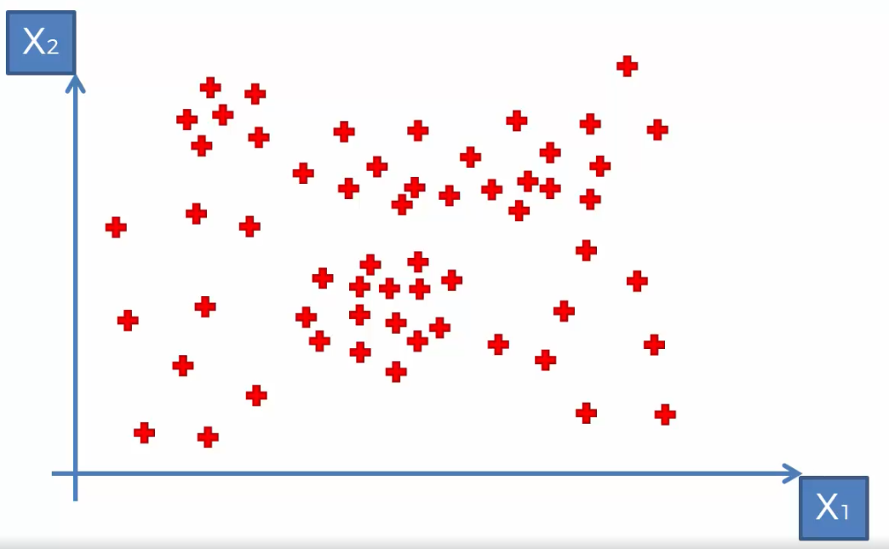
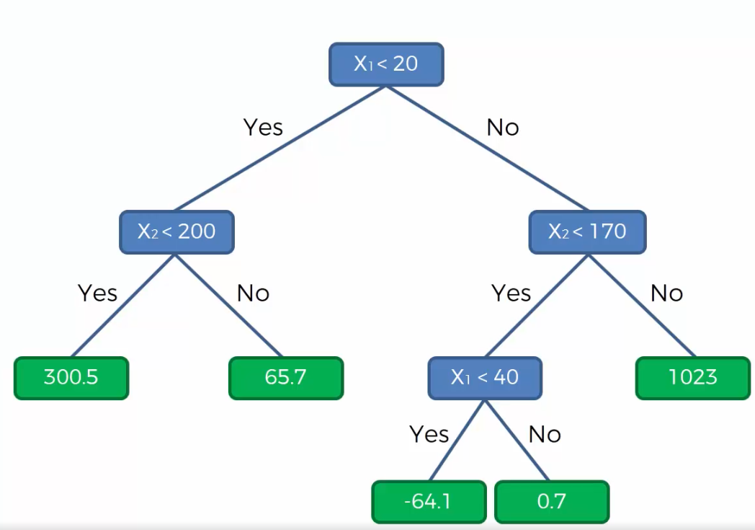
Decision Tree Desc
65.7
1023
200
170
300.5
0.7
-64.1
20
40
Notes:
Algorithm decides the splits. Stops when its not adding useful information to the model (information entropy)

Slide 22

Random Forrest
Souped up Decision Trees
100’s of Decision trees built based on Random Sampling
Predict value in each tree
Calculate Average value from all trees – Result
Good for ironing out variation in dataset
Reduces chances of poor prediction*
E.g. Guess number of beans in jar
1 guess vs average guesses

Slide 23
Normal Distribution

Slide 24
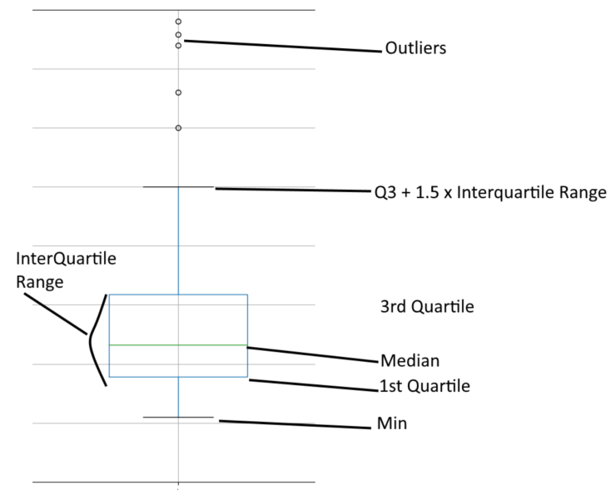

BoxPlot
Shows Distribution
Kind of like histogram on its side
Does not show quantities

